Slide 1
Intro to Computer Vision
Sean Levorse

Slide 2
Introduction

Slide 3
The Problem
Construct a neural network that can identify facial expressions
The dataset:
2013 Kaggel Challenge for Facial Recognition
7 Facial Expressions
48x48 greyscale images
28709 Training images
3589 Public and 3589 Private validation images

Slide 4
Challenges
Localization
Dataset is centered around the face
Lighting and Skin
Normalize images
Resources
Time
Technology
Incorrectly labelled data

Slide 5
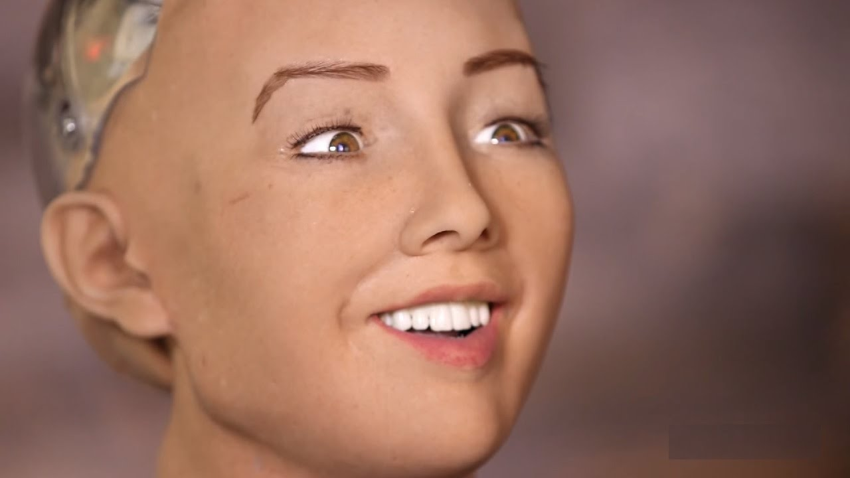
Applications of Facial Expression Recognition
HCI design - Improve communication between humans and computers
Robotics and AI design

Slide 6
Past Related Work

Slide 7
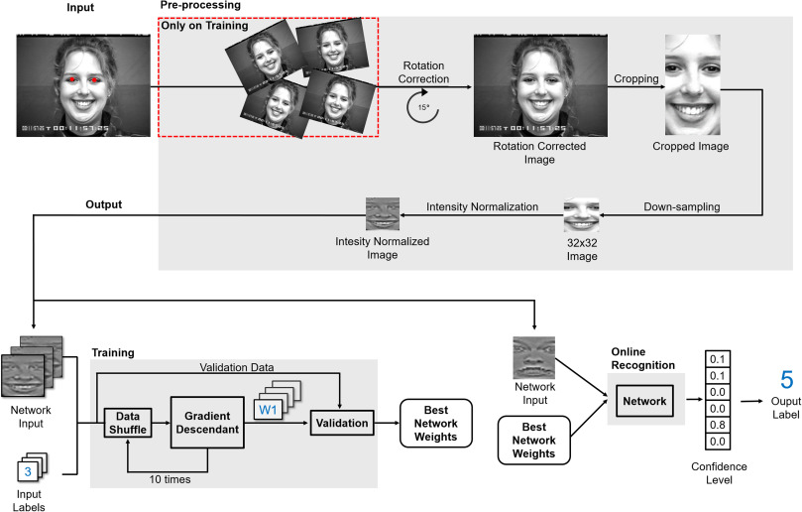
Facial expression recognition with convolutional neural networks: Coping with few data and the training sample order
Issue with faces being oriented at any rotation
Fixed this by rotating the image to align the eyes
Issue with lighting and skin color
Fixed with normalization
Shuffling data after each epoch

Slide 8
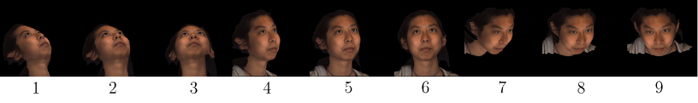
ERA 2017 - addressing head pose in the third facial expression recognition and analysis challenge
More issues with orientation
Stem from most datasets being composed of posed pictures
Instead of faces being rotated on a 2d plane, faces can be oriented at any angle
Define set of poses to incorporate different angles into the learning process

Slide 9
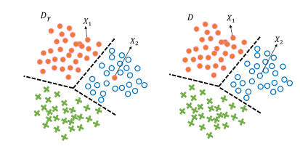
Multiclass Learning With Partially Corrupted Labels
Proposes treating incorrectly labelled data as noise
Works well with SVM classifiers
Importance reweighting based on how many nearby datapoints are the same class

Slide 10
Proposed Approach

Slide 11
Setup and Architecture
The network is created using Keras and a TensorFlow backend
Due to difficulties with Cuda, I was unable to get the graphics card to work
Normalize the images
Feed into CNN
Feed feature vector into deep network
Softmax output of deep net

Slide 12
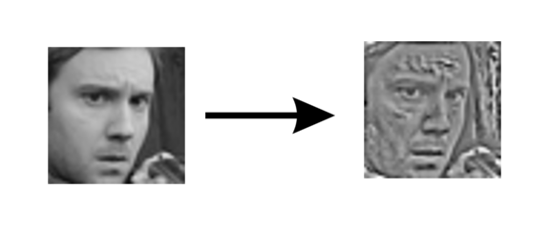

Image Normalization
$x^{′}= \frac{x −μ_{mhgx}}{σ_{mhgx}}$
Using kernel of size 7
From Lopes et al.

Slide 13
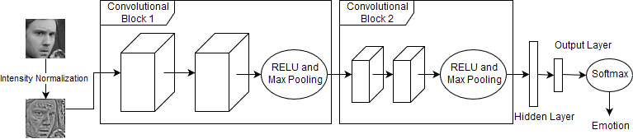
Keras Model
2 convolution blocks
2 convolutional layers each block
RELU activation
Max pooling between blocks
Flatten into 144 long vector
Hidden layer with 144 nodes
Output layer with 7 nodes

Slide 14
Experiments and Results

Slide 15
Trial and error
Started with basic network, 1 convolutional layer, 14 filters, 5x5 kernel, and one fully connected output layer:
Training accuracy: 0.192
Validation accuracy: 0.155
Changed to 2 convolutional layers, 1 fully connected hidden layer, 1 output layer
Training accuracy: 0.231
Validation accuracy: 0.210
Added image normalization:
Training accuracy: 0.258
Validation accuracy: 0.214

Slide 16
Trial and error
Switched activation from RELU to sigmoid
Training accuracy: 0.228
Increase number of epochs:
Training accuracy: 0.324
Validation accuracy: 0.260
Changed from SGD to RMSprop:
Training accuracy: 0.387
Validation accuracy: 0.341
With 20 epochs:
Training accuracy: 0.529
Validation accuracy: 0.4717

Slide 17
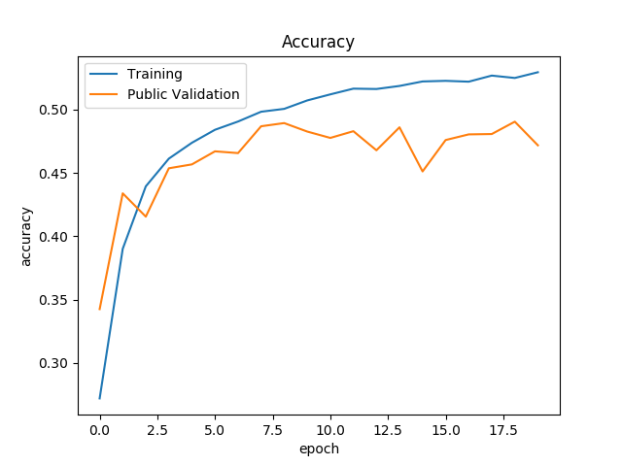
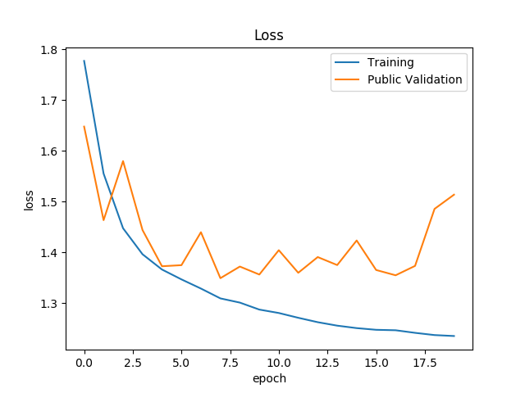
Results

Slide 18
Conclusion and Future Work

Slide 19
What I learned and future work
Saving data saves time
Finding the best model for a specific dataset takes a lot of tweaking
Try out different regulizers
Explore different kernels
Change sizes
Move away from square kernels
Using SVM instead of softmax
Implement importance reweighting to deal with mislabeled data
Try out pretraining

